Slide 1

Mystery Machine ECS/fargate Service Deployment
Sprint 63

Slide 2
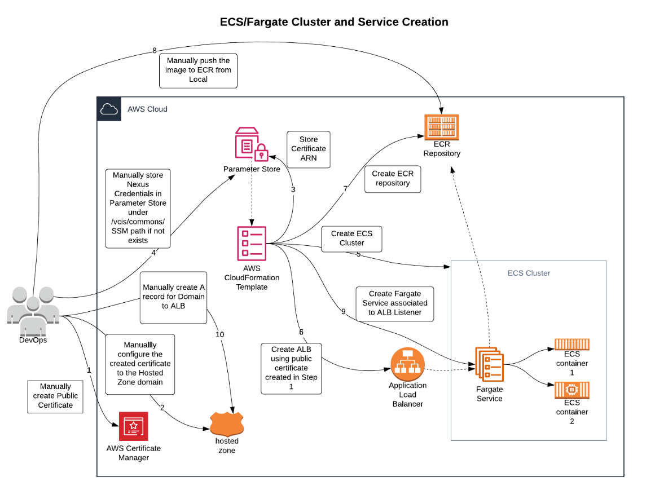
ECS/FARGATE CLUSTER CREATION

Slide 3
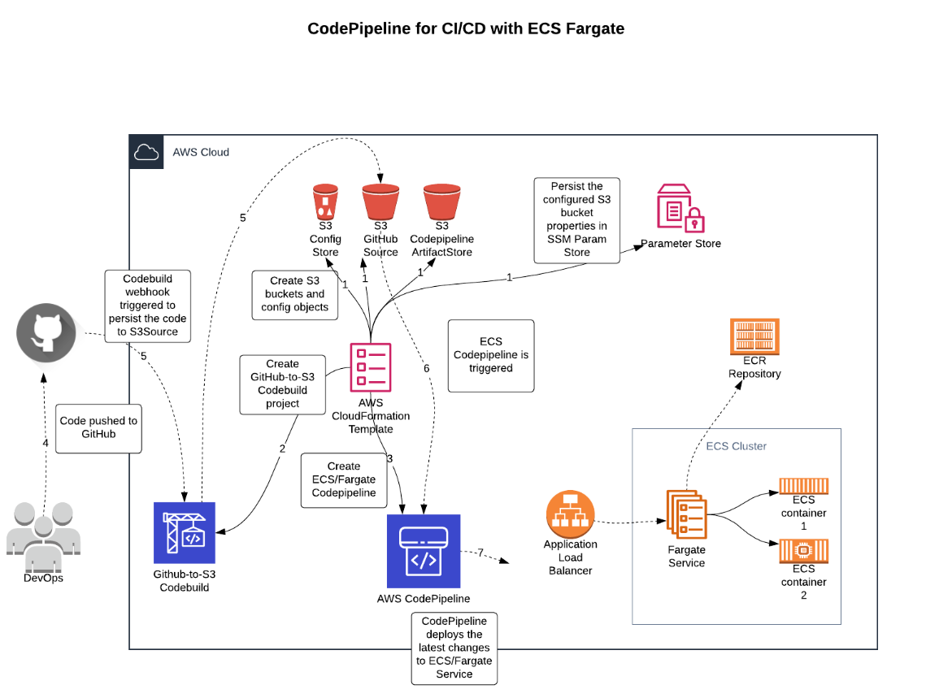
ECS/FARGATE CODEPIPELINE

Slide 4
DOCUMENTATION
https://vc-docs.velocity-np.ag/industry-system/ecs-fargate/

